Slide 1
Economic Consequences of Hospitalization for Older Workers Across Countries
Dr. Syed Hassan Raza
Chinese University of Hong Kong

Slide 2
Introduction: Health and earnings at older ages
Work in later life : Crucial Period for building retirement savings
Lagakos, Moll, Porzio, Qian and Schoellman (2018)
This period is also much more susceptible to health shocks
45-64 year olds 33% more likely to have overnight hospitalization than
20-44 year olds in the US (US Dept of Health and Human Service, 2015)
Thus insurance against health shocks may be critical to financial well-being for older workers.

Slide 3
Introduction: Health and earnings at older ages
Health shocks are multi-dimensional
Direct health changes
Short-term work absence
Long-term disability
Health insurance is often uni-dimensional
Health insurance covers direct medical expenditures
Oftentimes does not cover illness-related lost wages
Other types of insurance cover the latter losses
Unemployment insurance
Disability insurance
Worker’s compensation

Slide 4
Research questions
What are the economic consequences of health shocks among older workers across countries?
Out-of-pocket medical expenses, employment, earnings
Spousal earnings, social insurance payments, household income
What are potential reasons behind the differences we find?
Social insurance differences across countries
Differences in health status pre- and post-hospitalization
To answer these questions:
We follow Dobkin, Finkelstein, Kluender and Notowidigdo (2018), who study this in the US:
Event-study around a hospitalization
We use Gateway to Global Ageing Data (harmonized HRS-family surveys)
US, 15 European countries, and China

Slide 5
Why a cross-country analysis?
Harmonized data makes more consistent comparison possible
More certain that differences across countries are due to economic, institutional, and cultural differences
Helps to understand importance of institutional / cultural / economic factors in protecting against health risks
Lens through which to validate models of household behavior

Slide 6
Data and Sample restrictions
Data:
United States (HRS, 2000-2014)
China (CHARLS, 2010-2014)
Europe (SHARE, 2007-2015)
Northern: Denmark, Estonia, Ireland, Sweden
Western: Austria, Belgium, France, Germany, Luxembourg
Southern: Croatia, Greece, Italy, Portugal, Slovenia, Spain
Sample:
Individuals aged 50-59 with health insurance & hospitalization
Interviewed each wave (every two years)
Outcome variables:
Out-of-pocket medical expenses
Respondent earnings, working status
Social insurance payments, spousal earnings, total household income

Slide 7
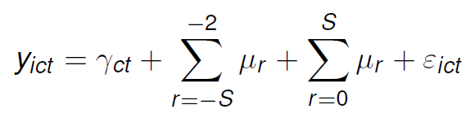
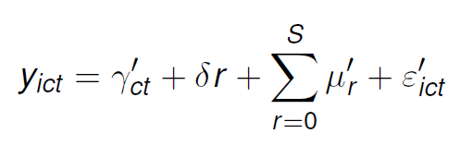
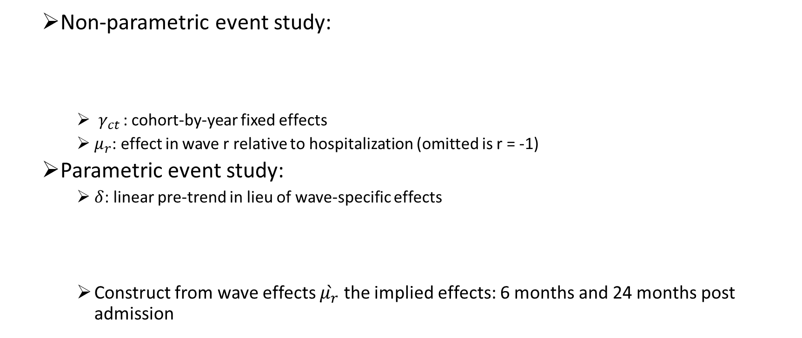
Empirical strategy following Dobkin et al (2018)
Non-parametric event study:
$γ_{ct }$: cohort-by-year fixed effects
$μ_{r}$: effect in wave r relative to hospitalization (omitted is r = -1)
Parametric event study:
$δ$: linear pre-trend in lieu of wave-specific effects
Construct from wave effects $\grave{μ_{r}}$ the implied effects: 6 months and 24 months post admission

Slide 8
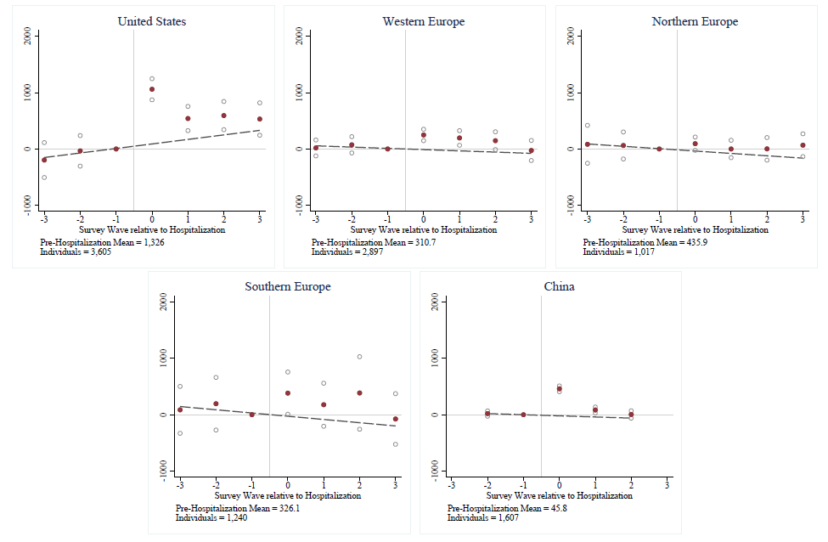
Results: Impact on out of pocket medical spending
US, Western Europe, and China have significantly higher medical expenditures following a hospitalization.

Slide 9
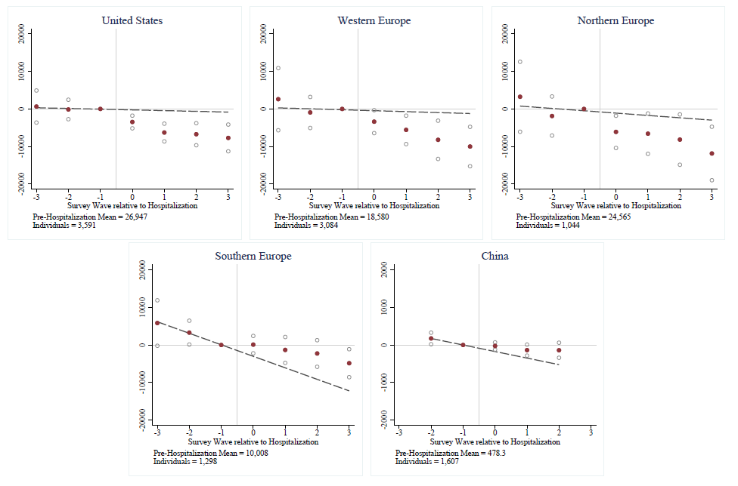
Results: Impact on own earnings
US and Western Europe have a significant earnings drop following a hospitalization.

Slide 10
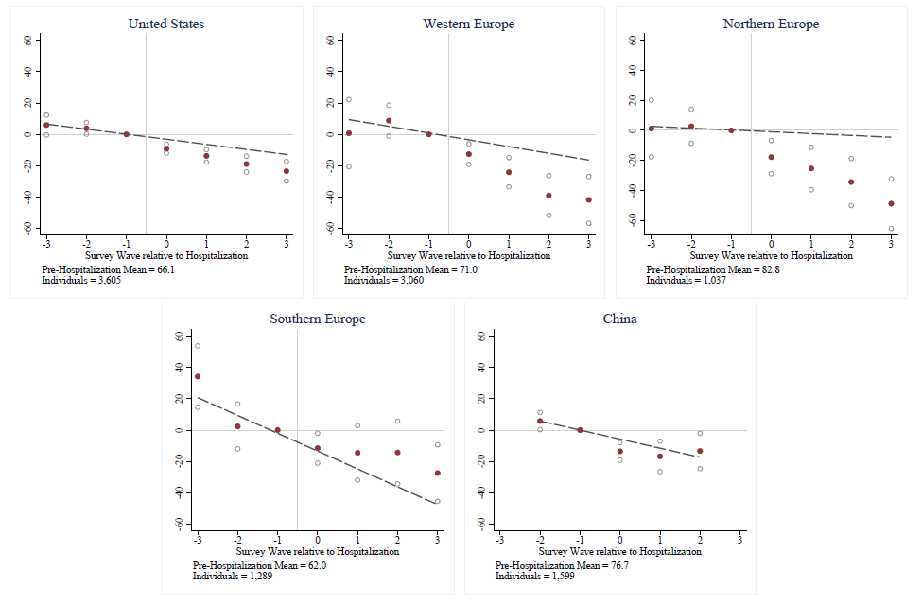
Results: Impact on working status
US, Western Europe, and Northern Europe have significantly lower probability of staying working following a hospitalization.

Slide 11
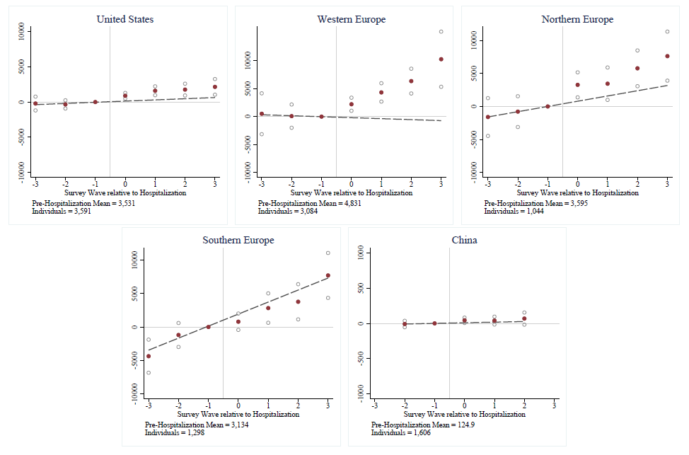
Results: Impact on social insurance payments
US and Western Europe have significantly higher social insurance payments following a hospitalization.

Slide 12
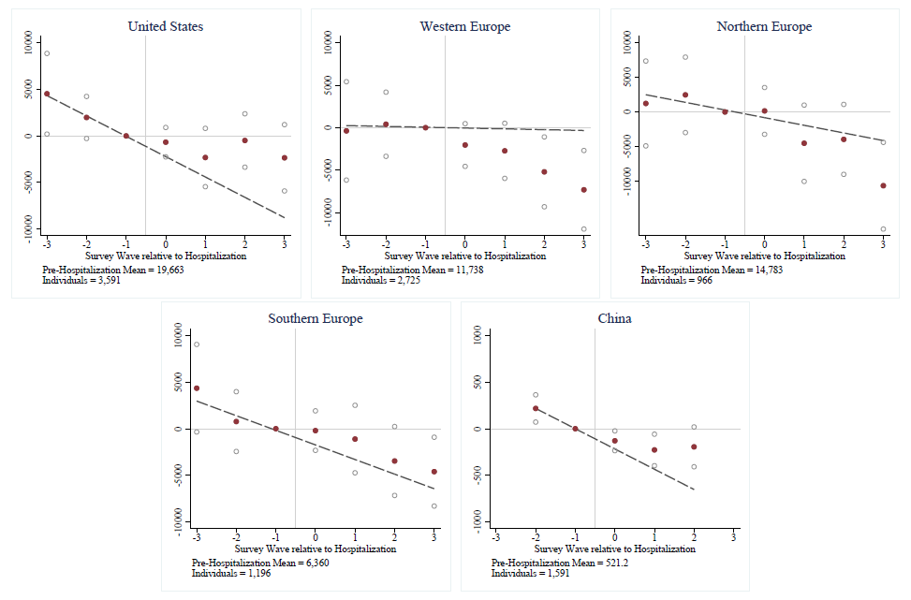
Results: Impact on spousal earnings
US and China have some evidence of insurance through spousal earnings
following a hospitalization.

Slide 13
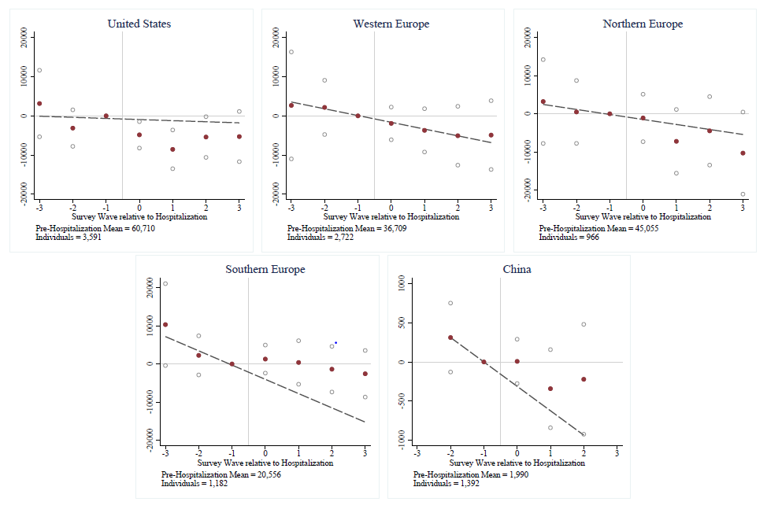
Results: Impact on household income
US has significant decline in household total income following a hospitalization.

Slide 14
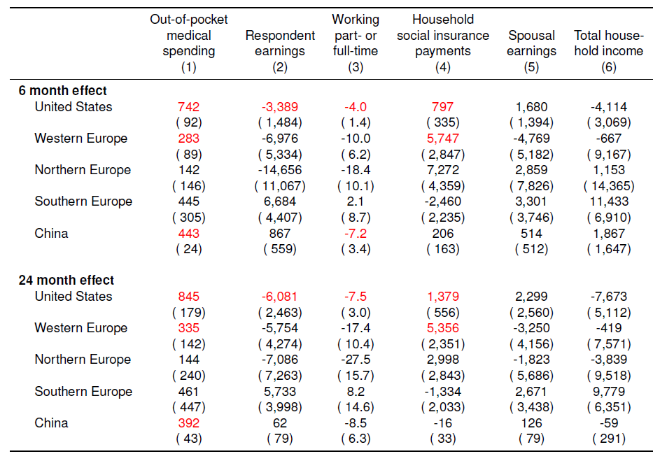
Results: Implied effects from hospitalization 6-month and 24-month post admission

Slide 15
Results and Discussion
Northern and Southern Europe: relatively well insured in terms of both out-of-pocket medical expenses and labor market outcomes.
Western Europe and US: evidence of increase in out-of-pocket medical expenses, decline in earnings, and increase in social insurance payments. Total household income in the US declines.
China: evidence of very large (relative to income) increase in out-of-pocket medical expenses.

Slide 16
Statutory paid sick leaves around the world
OECD countries (Heymann, Schmitt and Earle, 2009):
Norway, Luxembourg – 50 FTE days’ pay
Austria – 46
Germany – 44
Belgium – 39
Sweden – 38
Denmark – 36
Netherlands – 35
Spain – 32
Italy, Greece – 29
France – 24
Ireland – 17
Switzerland – 15
US – 0
China: 18 (Ministry of Labor, 1994)

Slide 17
Institutional Differences
Health insurance systems around the world
Four broad models of healthcare systems:
Beveridge model: single-payer & provider, financed through taxes
UK, Scandinavia (Northern Europe), Greece, Italy and Spain (Southern Europe)
Bismark model: Tightly regulated multi-payer & provider system
Belgium, Germany, France and Switzerland (Western Europe), and urban China
National health insurance model: single-payer & multi-provider
Canada
Out-of-pocket model: market-driven healthcare
Rural China and most developing countries
The US healthcare system is a unique combination of the four models.

Slide 18
Conclusion
Adverse health shocks can lead to adverse financial outcomes
We conduct an event study around a hospitalization across countries
Main Findings
Northern and Southern Europe: little exposure to either costs
US and Western Europe: exposure to both, esp. US
China: large exposure to health costs but not labor costs
Broadly consistent with differences in generosity of social health protection programs
Future Work:
Other countries (even within G2Aging data!)
Other risks: disability, long-term care, etc.

